Slide 1
Red-Green Color Blindness
Genetic Counseling

Slide 2
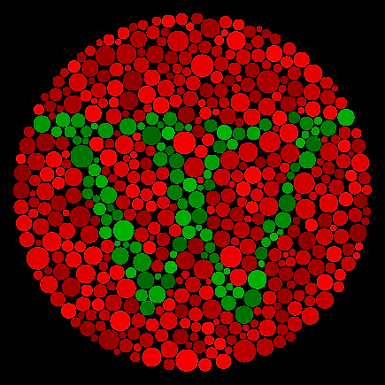
Overview of the Disease
It is a visual-deficiency disorder.
Red-blindness is caused by either lack or having sensitive cones (abnormal long wavelength).
Green-blindness/ Dichromats.
Notes:
The disease causes a person to see a variety of colors differently than the normal. Red and green are the predominant color-perception problem. The sensitive cones are responsible for the red part of sight. Green-blindness (dichromats) are caused by the lack medium wavelengths of sensitive cons.

Slide 3

Symptoms
Color and brightness perception difficulties.
Shade-perception difficulties.
Poor vision.
Notes:
A person with red-green color blindness are unable to perceive colors and their brightness correctly. Also, individuals experience difficulties of differentiating between shades of similar colors. Lastly, victims can have poor vision at extreme cases (Turbert, 2019).

Slide 4
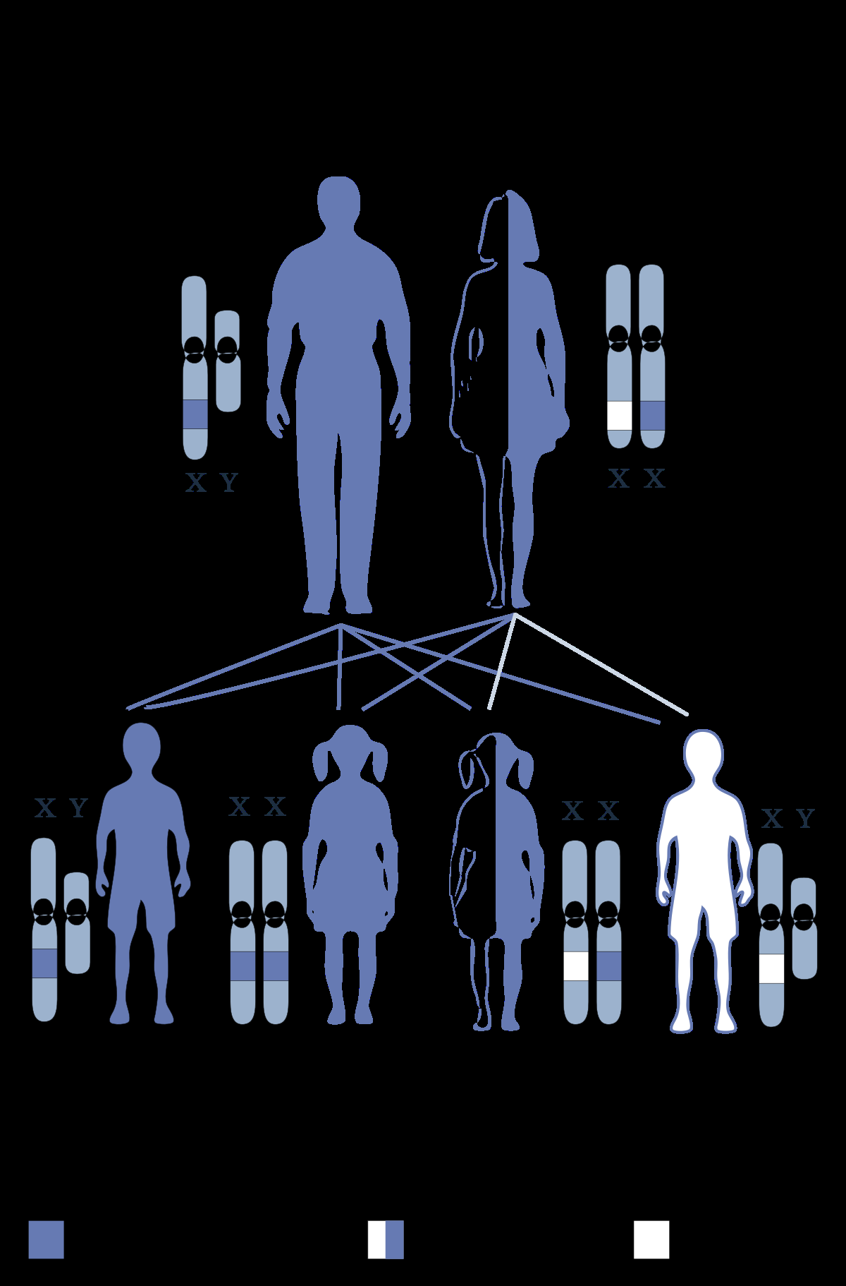
Pattern of Inheritance
X-Chromosomes.
Males’ pattern of inheritance.
Females’ pattern of inheritance.
Notes:
The gene for color blindness is carried on the X chromosome. Only men have one X chromosome. If their X chromosomes carry the color-blindness genes, they will be blind (XY). Women have two X-chromosomes. Two normal X-Chromosomes will not lead to color blindness. One normal chromosome (X) and another carrying causing the color-blindness gene (X) will cause a female to be a carrier (XX).

Slide 5
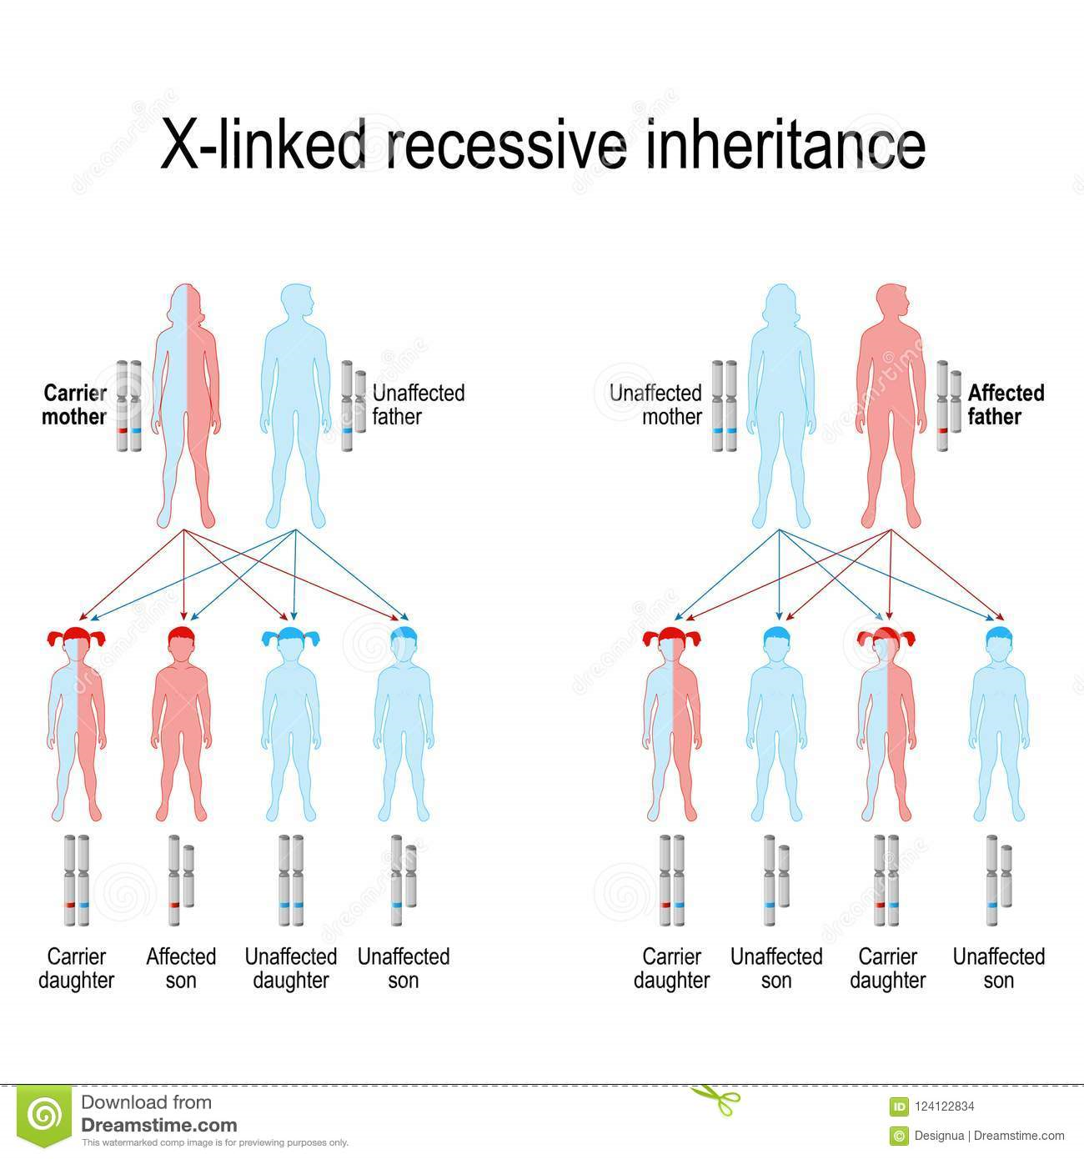
Cont.
Inheritance on rare occasions among females.
Passage to sons.
Notes:
On rare occasions, a female can inherit a color blind X-chromosome from their fathers and X-color blind from their mothers; therefore, becoming color blind (XX). As a result, they pass the color-blindness genes to their sons (Color Blindness Awareness, n. d).

Slide 6
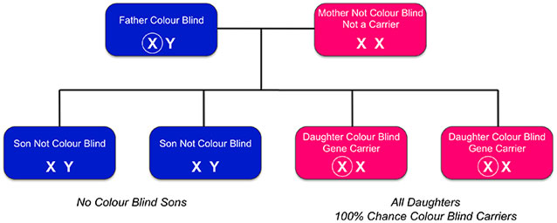
Role of Parents in Inheritance
Mother-son inheritance.
Mother as a carrier.
Exception for daughters.
Notes:
Red/ green color blindness is passed on from mothers to their sons on the twenty-third chromosomes. If a woman has a color-blind gene (carrier) she cannot be color blind. She passes one of her X chromosomes to her child. If the gene faulty, her son is likely to be color-blind while the daughter will not. Daughters can be carriers when the mothers are carriers or the father is color-blind.

Slide 7
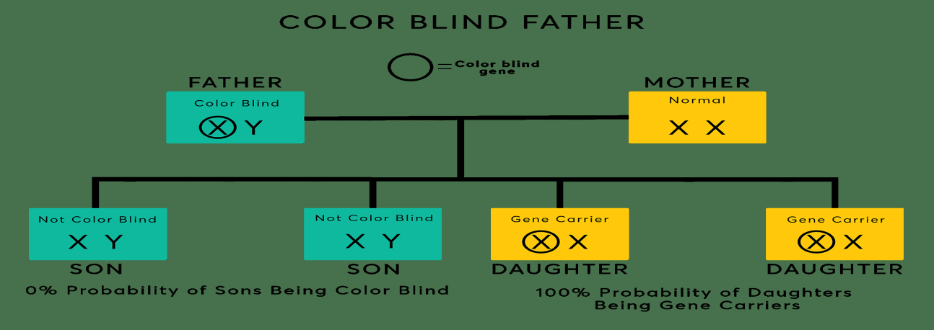
Father-Daughter Inheritance
Commonness in men than in women.
Daughter color-blindness.
Daughter can be carrier in two ways.
Notes:
Red-green color blindness is common in men than in women since daughters can only be carriers when their mothers are carriers or the fathers are color-blind. If a father is not color blind, a carrier daughter cannot be color blind. A daughter can only be a carrier when the mother is a carrier or the father is color-blind.

Slide 8
References
Color Blindness Awareness. (n. d). Inherited color vision deficiency. Retrieved from
http://www.colourblindawareness.org/col our-blindness/inherited-colour-vision- deficiency/
Tubert, D. (2019). What are the symptoms and the causes of color blindness. Retrieved from
https://www.aao.org/eye- health/diseases/color-blindness- symptoms

